Slide 1
Voyage Account

Slide 2
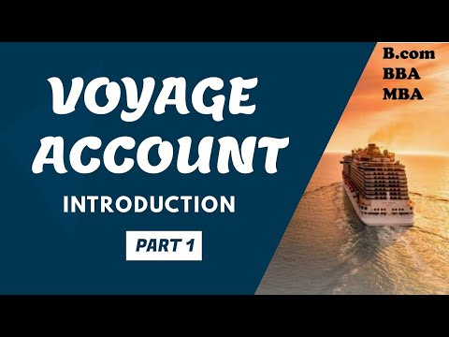
Introduction to Voyage Account
A Voyage account is a specialized financial account designed for maritime activities.
It facilitates transactions related to shipping, logistics, and maritime services.
Understanding Voyage accounts is essential for businesses involved in international trade and shipping.
Notes:
Image source: https://www.youtube.com/watch?v=EQfItpC_aes

Slide 3
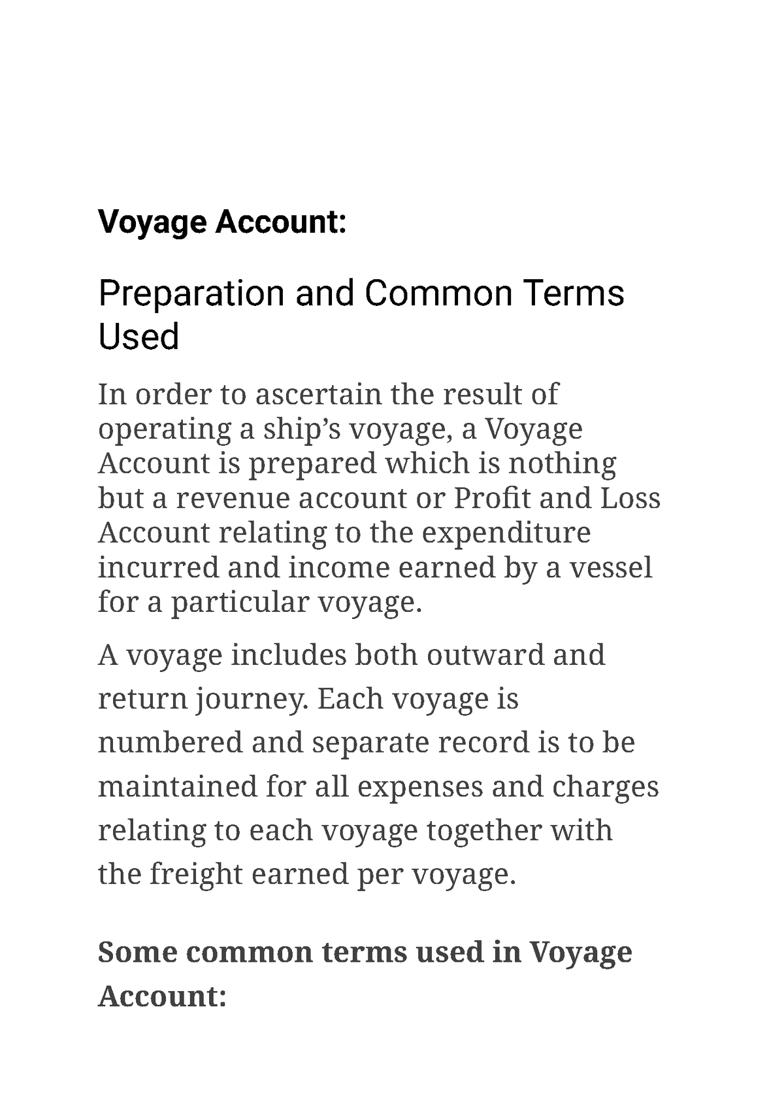
Purpose of Voyage Account
The primary purpose of a Voyage account is to streamline financial operations at sea.
It helps ship owners and operators manage costs associated with voyages efficiently.
This account type allows for the tracking of expenses and revenues specific to each voyage.
Notes:
Image source: https://www.studocu.com/in/document/university-of-kerala/financial-accounting/voyage-account/26270854

Slide 4
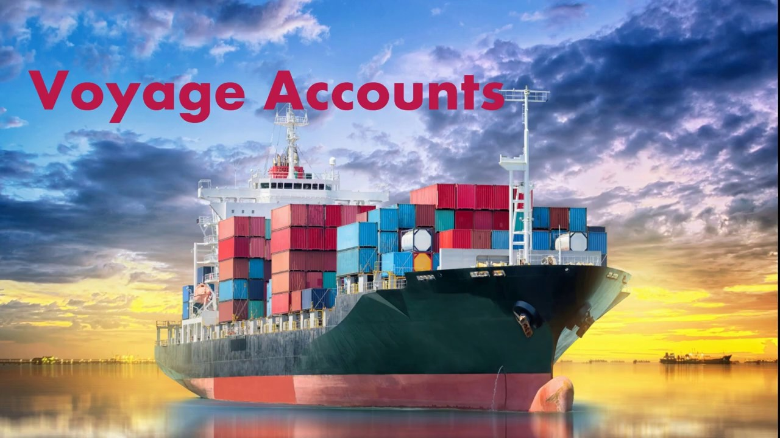
Key Features of Voyage Account
Voyage accounts offer dedicated financial management tools tailored for maritime needs.
They often include multi-currency support to accommodate international transactions.
Users can benefit from real-time reporting and analytics to monitor financial performance.
Notes:
Image source: https://www.youtube.com/watch?v=ktuJEXQhOmA

Slide 5
Benefits of Using Voyage Account
Utilizing a Voyage account can enhance financial transparency within maritime operations.
It helps in budgeting by providing detailed insights into voyage-related expenses.
Companies can improve cash flow management by aligning their financial planning with voyage schedules.
Notes:
Image source: https://www.youtube.com/watch?v=EQfItpC_aes

Slide 6
Common Transactions in Voyage Account
Transactions in a Voyage account may include fuel purchases, port fees, and crew salaries.
It can also encompass freight charges and logistical costs associated with cargo handling.
These transactions are tracked to provide a comprehensive overview of voyage financials.
Notes:
Image source: https://www.studocu.com/in/document/university-of-kerala/financial-accounting/voyage-account/26270854

Slide 7
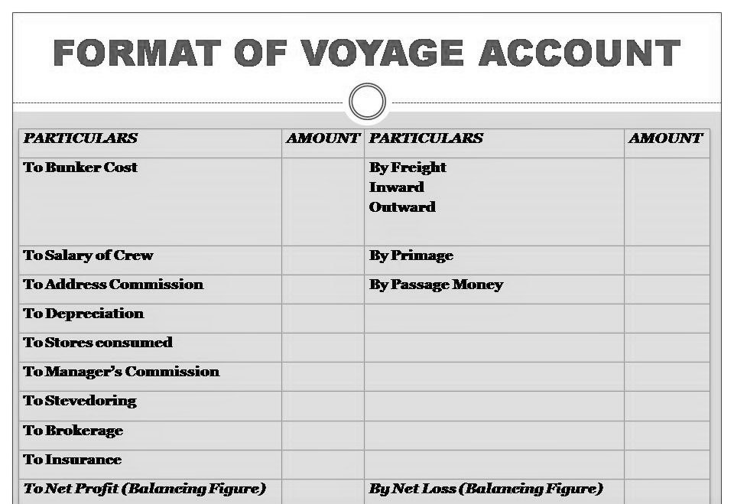
Voyage Account Management
Effective management of a Voyage account requires diligent record-keeping practices.
Regular reconciliations are necessary to ensure accuracy of financial data.
Utilizing accounting software can greatly simplify the management process for maritime businesses.
Notes:
Image source: https://intactone.com/voyage-accounts-meaning-preparation-of-voyage-accounts/

Slide 8
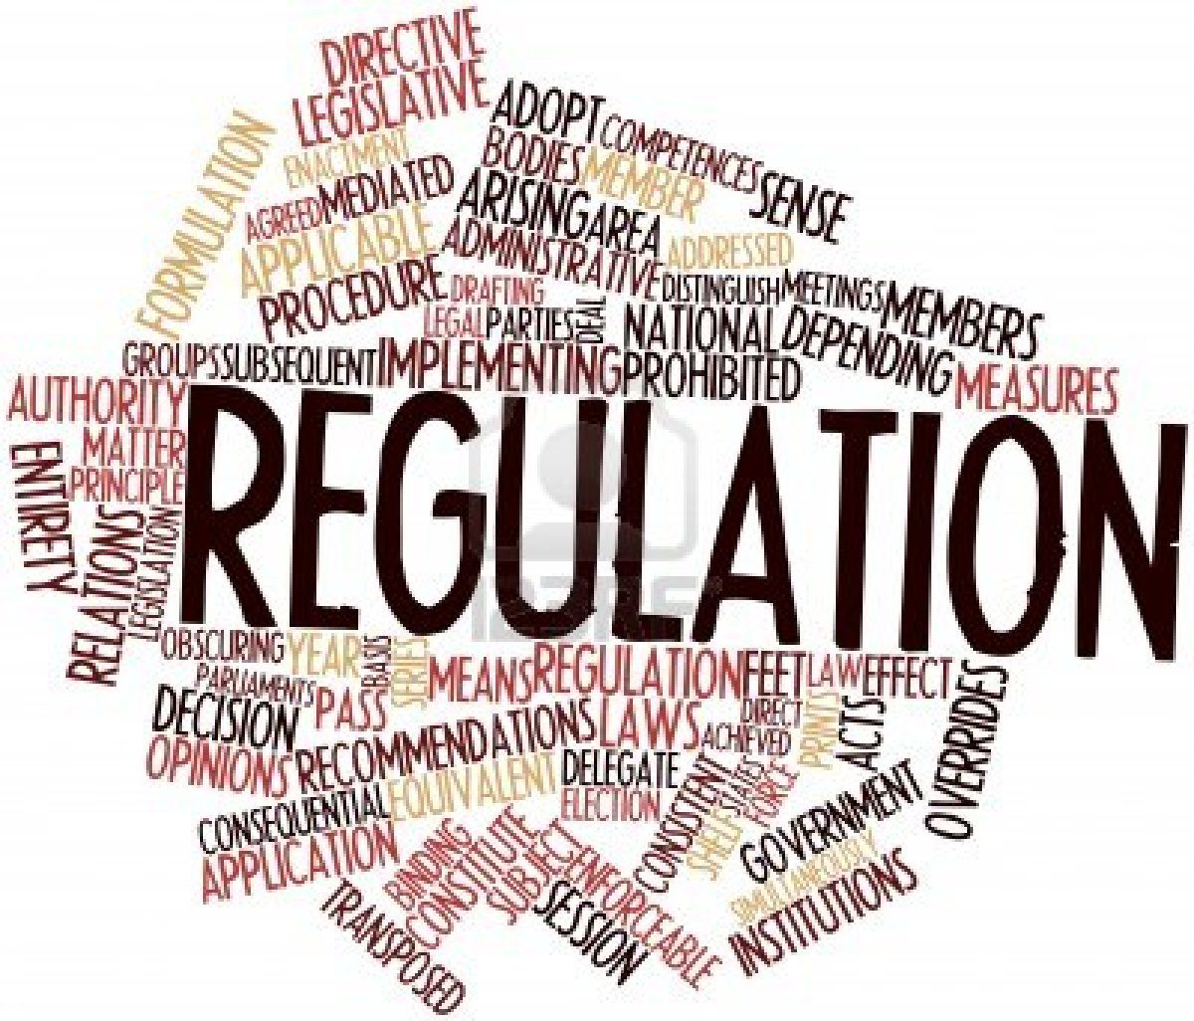
Regulatory Considerations
Voyage accounts must comply with maritime laws and financial regulations.
Different jurisdictions may have specific requirements for reporting and taxation.
Understanding these regulations is crucial to avoid legal complications and financial penalties.
Notes:
Image source: https://legal-planet.org/2021/06/24/the-regulatory-process-faqs/

Slide 9
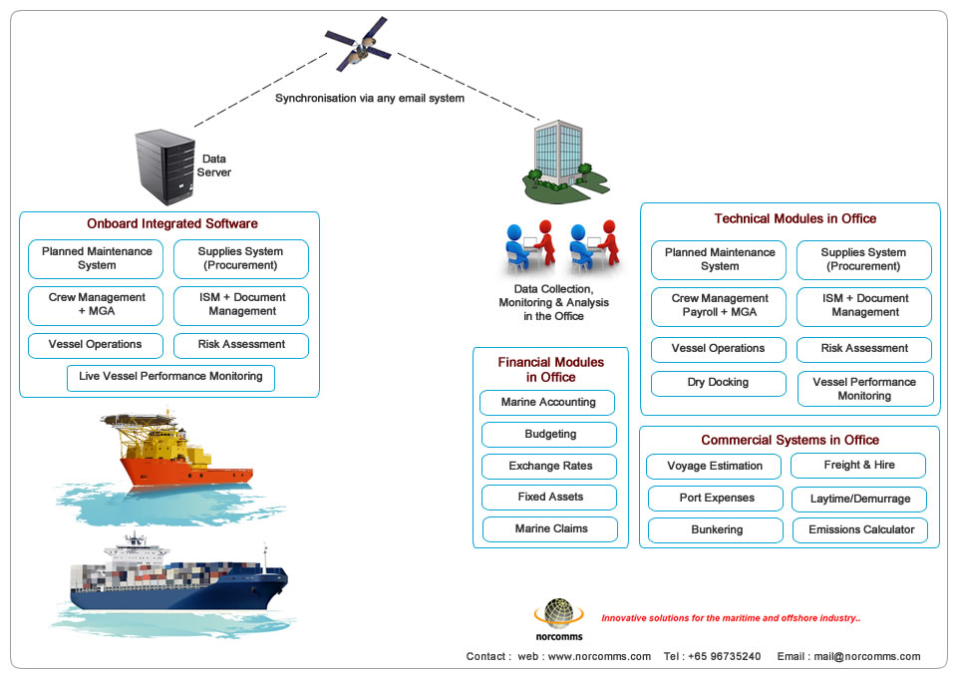
Technology Integration
Modern Voyage accounts often integrate with advanced maritime technology solutions.
This includes software for tracking shipments, managing crew schedules, and optimizing routes.
Technology enhances the efficiency and accuracy of financial data related to voyages.
Notes:
Image source: http://www.norcomms.com/solutions.php

Slide 10
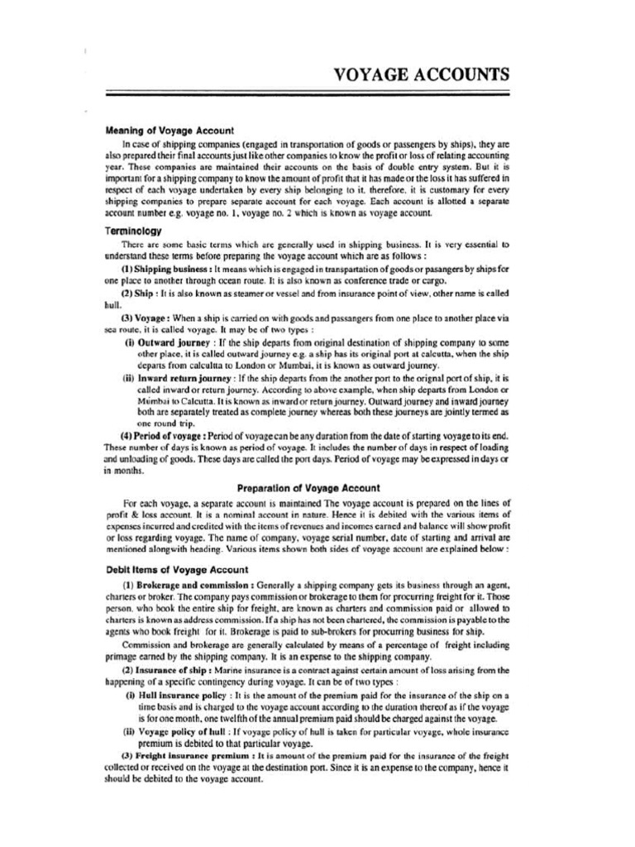
Case Studies of Voyage Accounts
Numerous shipping companies have successfully implemented Voyage accounts to boost profitability.
Case studies highlight strategies used to reduce costs and enhance operational efficiency.
Learning from these examples can provide valuable insights for other maritime businesses.
Notes:
Image source: https://www.scribd.com/document/259880158/Voyage-Accounts

Slide 11
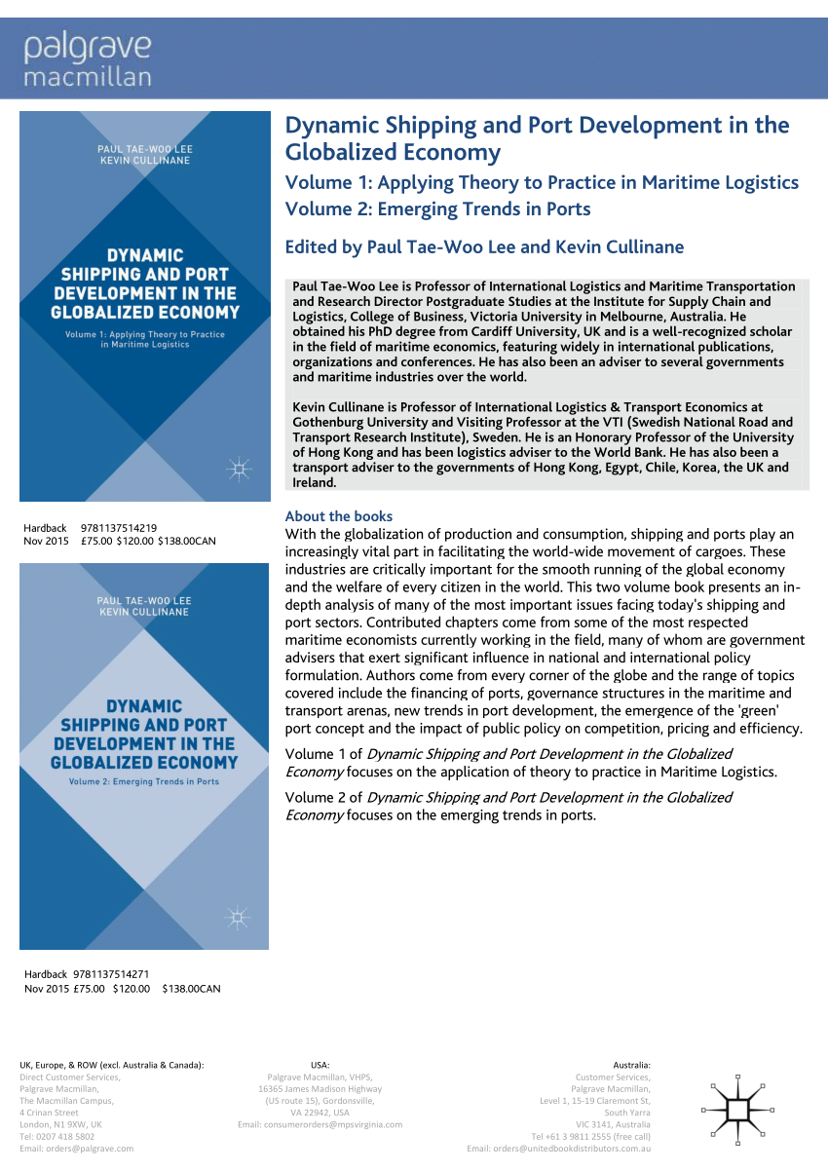
Conclusion and Future Trends
Voyage accounts are becoming increasingly essential in a globalized shipping environment.
Future trends may include more automation and integration with blockchain technology.
Staying informed about these developments can help businesses maintain a competitive edge.
Notes:
Image source: https://www.researchgate.net/publication/283724626_Dynamic_Shipping_and_Port_Development_in_the_Globalized_Economy_Volume_1_Applying_Theory_to_Practice_in_Maritime_Logistics_Volume_2_Emerging_Trends_in_Ports_About_the_books_With_the_globalization_of_p

